Slide 1

TEAM J
Edel Jhon Cenario
Javier Marquez
Justin Paras
Jose Quinteros

Slide 2
FEATURES
Create an Account
Login to an Account
Create a game
Join a game
Global Chat
Private Chat

Slide 3
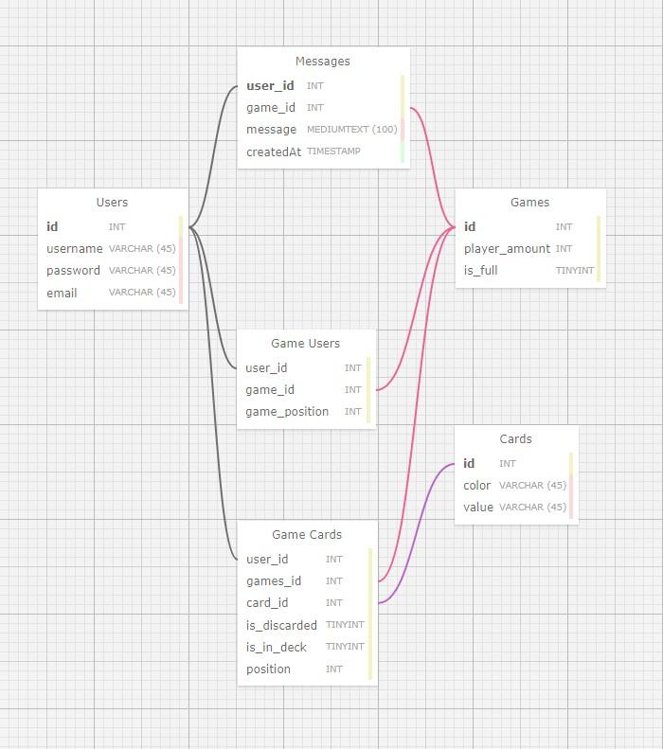
WIREFRAME

Slide 4
TECHNOLOGIES
PostgreSQL
Express
Socket.io
NodeJS
Pug & css

Slide 5
REFLECTION

Slide 6
DEMO

